Slide 1
INST 346 Spring 2025
Lecture 20
April 9, 2025
Professor Keith Marzullo

Slide 2
Network layer control plane
Network layer functions
Scalable routing
Routing among the ISPs: BGP
Software defined networking (SDN)
ICMP
Network management

Slide 3
Network layer functions

Slide 4
Network-layer functions
forwarding: move packets from router’s input to appropriate router output
data plane
routing: determine route taken by packets from source to destination
control plane
Two approaches to structuring network control plane:
per-router control (traditional)
logically centralized control (software defined networking)

Slide 5

Per-router control plane
Individual routing algorithm components in each and every router interact in the control plane
Routing
Algorithm
control
plane
data
plane
values in arriving
packet header
0111
1
3
2

Slide 6
Software-Defined Networking (SDN) control plane
Remote controller computes, installs forwarding tables in routers
Remote Controller
control
plane
data
plane
CA
CA
CA
CA
CA
values in arriving
packet header
0111
1
3
2

Slide 7
Scalable routing

Slide 8
Internet approach to scalable routing
aggregate routers into regions known as “autonomous systems” (AS) (a.k.a. “domains”)
intra-AS (aka “intra-domain”): routing among routers within same AS (“network”)
all routers in AS must run same intra-domain protocol
routers in different AS can run different intra-domain routing protocols
gateway router: at “edge” of its own AS, has link(s) to router(s) in other AS’es

Slide 9
Internet approach to scalable routing
aggregate routers into regions known as “autonomous systems” (AS) (a.k.a. “domains”)
intra-AS (aka “intra-domain”): routing among routers within same AS (“network”)
all routers in AS must run same intra-domain protocol
routers in different AS can run different intra-domain routing protocols
gateway router: at “edge” of its own AS, has link(s) to router(s) in other AS’es
inter-AS (aka “inter-domain”): routing among AS’es
gateways perform inter-domain routing (as well as intra-domain routing)

Slide 10
Making routing scalable
our routing study thus far - idealized
all routers identical
network “flat”
… not true in practice
scale: billions of destinations:
can’t store all destinations in routing tables!
routing table exchange would swamp links!
administrative autonomy:
Internet: a network of networks
each network admin may want to control routing in its own network

Slide 11
Intra-AS routing: routing within an AS
most common intra-AS routing protocols:
RIP: Routing Information Protocol [RFC 1723]
classic DV: DVs exchanged every 30 secs
no longer widely used
EIGRP: Enhanced Interior Gateway Routing Protocol
DV based
formerly Cisco-proprietary for decades (became open in 2013 [RFC 7868])
OSPF: Open Shortest Path First [RFC 2328]
link-state routing
IS-IS protocol (ISO standard, not RFC standard) essentially same as OSPF

Slide 12
OSPF (Open Shortest Path First) routing
“open”: publicly available
classic link-state
each router floods OSPF link-state advertisements (directly over IP rather than using TCP/UDP) to all other routers in entire AS
multiple link costs metrics possible: bandwidth, delay
each router has full topology, uses Dijkstra’s algorithm to compute forwarding table
security: all OSPF messages authenticated (to prevent malicious intrusion)

Slide 13
Hierarchical OSPF
two-level hierarchy: local area, backbone.
link-state advertisements flooded only in area, or backbone
each node has detailed area topology; only knows direction to reach other destinations
area border routers: “summarize” distances to destinations in own area, advertise in backbone
boundary router: connects to other ASes
backbone
backbone router: runs OSPF limited to backbone
local routers:
flood LS in area only
compute routing within area
forward packets to outside via area border router
area 3
internal
routers
area 1
area 2

Slide 14
Routing among the ISPs: BGP

Slide 15
Internet inter-AS routing: BGP
BGP (Border Gateway Protocol): the de facto inter-domain routing protocol
“glue that holds the Internet together”
allows subnet to advertise its existence, and the destinations it can reach, to rest of Internet: “I am here, here is who I can reach, and how”
Notes:
Since an inter-AS routing protocol involves coordination among multiple ASs, communicating ASs must run the same inter-AS routing protocol. In fact, in the Internet, all ASs run the same inter-AS routing protocol, called the Border Gateway Protocol, more commonly known as BGP

Slide 16
Internet inter-AS routing: BGP
BGP (Border Gateway Protocol): the de facto inter-domain routing protocol
“glue that holds the Internet together”
allows subnet to advertise its existence, and the destinations it can reach, to rest of Internet: “I am here, here is who I can reach, and how”
BGP provides each AS a means to:
obtain destination network reachability info from neighboring ASes (eBGP)
determine routes to other networks based on reachability information and policy
propagate reachability information to all AS-internal routers (iBGP)
advertise (to neighboring networks) destination reachability info
Notes:
Since an inter-AS routing protocol involves coordination among multiple ASs, communicating ASs must run the same inter-AS routing protocol. In fact, in the Internet, all ASs run the same inter-AS routing protocol, called the Border Gateway Protocol, more commonly known as BGP

Slide 17
eBGP, iBGP connections
2b
∂
2a
2c
1b
3b
2d
∂
1a
1c
3a
3c
AS 2
1d
3d
AS 1
eBGP connectivity
AS 3
logical iBGP connectivity
1c
gateway routers run both eBGP and iBGP protocols

Slide 18
BGP basics
BGP session: two BGP routers (“peers”) exchange BGP messages over semi-permanent TCP connection:
advertising paths to different destination network prefixes (BGP is a “path vector” protocol)
AS 3
3b
AS 1
1b
3a
3c
1a
1c
AS 2
3d
2b
1d
2a
2c
2d

Slide 19
BGP basics
BGP session: two BGP routers (“peers”) exchange BGP messages over semi-permanent TCP connection:
advertising paths to different destination network prefixes (BGP is a “path vector” protocol)
when AS3 gateway 3a advertises path AS3,X to AS2 gateway 2c:
AS3 promises to AS2 it will forward datagrams towards X
AS 3
3b
AS 1
1b
3a
3c
1a
1c
AS 2
3d
X
2b
1d
2a
2c
BGP advertisement:
AS3, X
2d

Slide 20
Path attributes and BGP routes
BGP advertised route: prefix + attributes
prefix: destination being advertised
two important attributes:
AS-PATH: list of ASes through which prefix advertisement has passed
NEXT-HOP: indicates specific internal-AS router to next-hop AS

Slide 21
Path attributes and BGP routes
BGP advertised route: prefix + attributes
prefix: destination being advertised
two important attributes:
AS-PATH: list of ASes through which prefix advertisement has passed
NEXT-HOP: indicates specific internal-AS router to next-hop AS
policy-based routing:
gateway receiving route advertisement uses import policy to accept/decline path (e.g., never route through AS Y).
AS policy also determines whether to advertise path to other other neighboring ASes

Slide 22
Why different Intra-, Inter-AS routing ?
policy:
inter-AS: admin wants control over how its traffic routed, who routes through its network
intra-AS: single admin, so policy less of an issue
scale:
hierarchical routing saves table size, reduced update traffic
performance:
intra-AS: can focus on performance
inter-AS: policy dominates over performance

Slide 23
Hot potato routing
AS 3
3b
AS 1
1b
3a
3c
1a
1c
AS 2
3d
X
2b
112
1d
AS3,X
AS1,AS3,X
2a
2c
201
263
2d
OSPF link weights
2d learns (via iBGP) it can route to X via 2a or 2c
hot potato routing: choose local gateway that has least intra-domain cost (e.g., 2d chooses 2a, even though more AS hops to X): don’t worry about inter-domain cost!

Slide 24
BGP: achieving policy via advertisements
A,w
B
x
provider
w
A
network
legend:
C
customer
A,w
y
network:
ISP only wants to route traffic to/from its customer networks (does not want to carry transit traffic between other ISPs – a typical “real world” policy)
A advertises path Aw to B and to C
B chooses not to advertise BAw to C!
B gets no “revenue” for routing CBAw, since none of C, A, w are B’s customers
C does not learn about CBAw path
C will route CAw (not using B) to get to w

Slide 25
BGP: achieving policy via advertisements (more)
B
x
provider
w
A
network
legend:
C
customer
y
network:
ISP only wants to route traffic to/from its customer networks (does not want to carry transit traffic between other ISPs – a typical “real world” policy)
A,B,C are provider networks
x,w,y are customer (of provider networks)
x is dual-homed: attached to two networks
policy to enforce: x does not want to route from B to C via x
.. so x will not advertise to B a route to C

Slide 26
BGP route selection
router may learn about more than one route to destination AS, selects route based on:
local preference value attribute: policy decision
shortest AS-PATH
closest NEXT-HOP router: hot potato routing
additional criteria

Slide 27
Software defined networking (SDN)

Slide 28
Software defined networking (SDN)
Internet network layer: historically implemented via distributed, per-router control approach:
monolithic router contains switching hardware, runs proprietary implementation of Internet standard protocols (IP, RIP, IS-IS, OSPF, BGP) in proprietary router OS (e.g., Cisco IOS)
different “middleboxes” for different network layer functions: firewalls, load balancers, NAT boxes, ..
~2005: renewed interest in rethinking network control plane

Slide 29
Per-router control plane
Individual routing algorithm components in each and every router interact in the control plane to computer forwarding tables
Routing
Algorithm
control
plane
data
plane
values in arriving
packet header
0111
1
3
2

Slide 30
Software-Defined Networking (SDN) control plane
Remote controller computes, installs forwarding tables in routers
Remote Controller
control
plane
data
plane
CA
CA
CA
CA
CA
values in arriving
packet header
0111
1
3
2

Slide 31
Software defined networking (SDN)
Why a logically centralized control plane?
easier network management: avoid router misconfigurations, greater flexibility of traffic flows
table-based forwarding (recall OpenFlow API) allows “programming” routers
centralized “programming” easier: compute tables centrally and distribute
distributed “programming” more difficult: compute tables as result of distributed algorithm (protocol) implemented in each-and-every router
open (non-proprietary) implementation of control plane
foster innovation: let 1000 flowers bloom

Slide 32
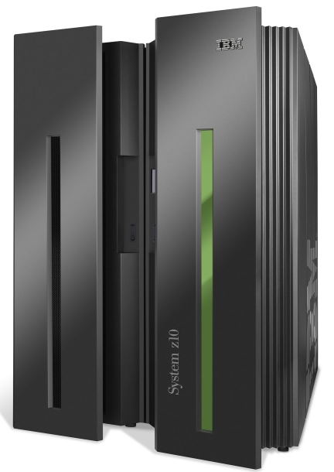
SDN analogy: mainframe to PC revolution
Specialized
Applications
Specialized
Operating
System
Specialized
Hardware
Vertically integrated
Closed, proprietary
Slow innovation
Small industry
* Slide courtesy: N. McKeown

Slide 33




SDN analogy: mainframe to PC revolution
App
App
App
App
App
App
App
App
App
App
App
Specialized
Applications
Open Interface
Specialized
Operating
System
or
or
Windows
Linux
MAC OS
Specialized
Hardware
Open Interface
Microprocessor
Vertically integrated
Closed, proprietary
Slow innovation
Small industry
Horizontal
Open interfaces
Rapid innovation
Huge industry
* Slide courtesy: N. McKeown

Slide 34

Traffic engineering: difficult with traditional routing
5
3
v
w
5
2
u
2
1
z
3
1
2
x
y
1
Q: what if network operator wants u-to-z traffic to flow along uvwz, rather than uxyz?
A: need to re-define link weights so traffic routing algorithm computes routes accordingly (or need a new routing algorithm)!
link weights are only control “knobs”: not much control!

Slide 35
Traffic engineering: difficult with traditional routing
5
3
v
w
5
2
u
2
1
z
3
1
2
x
y
1
Q: what if network operator wants to split u-to-z traffic along uvwz and uxyz (load balancing)?
A: can’t do it (or need a new routing algorithm)

Slide 36
Traffic engineering: difficult with traditional routing
5
3
v
w
5
2
u
2
1
z
3
1
2
x
y
1
Q: what if w wants to route blue and red traffic differently from w to z?
A: can’t do it (with destination-based forwarding, and LS, DV routing)
We learned in Chapter 4 that generalized forwarding and SDN can be used to achieve any routing desired

Slide 37
Software defined networking (SDN)
…
3. control plane functions external to data-plane switches
4. programmable control applications
routing
access control
load
balance
Remote Controller
control
plane
data
plane
CA
2. control, data plane separation
CA
CA
CA
CA
1: generalized “flow-based” forwarding (e.g., OpenFlow)

Slide 38
Software defined networking (SDN)
Data-plane switches:
fast, simple, commodity switches implementing generalized data-plane forwarding (Section 4.4) in hardware
flow (forwarding) table computed, installed under controller supervision
API for table-based switch control (e.g., OpenFlow)
defines what is controllable, what is not
protocol for communicating with controller (e.g., OpenFlow)
network-control applications
…
routing
access
control
load
balance
control
plane
northbound API
SDN Controller
(network operating system)
southbound API
data
plane
SDN-controlled switches

Slide 39
Software defined networking (SDN)
SDN controller (network OS):
maintain network state information
interacts with network control applications “above” via northbound API
interacts with network switches “below” via southbound API
implemented as distributed system for performance, scalability, fault-tolerance, robustness
network-control applications
…
routing
access
control
load
balance
control
plane
northbound API
SDN Controller
(network operating system)
southbound API
data
plane
SDN-controlled switches

Slide 40
Software defined networking (SDN)
Network-control apps:
“brains” of control: implement control functions using lower-level services, API provided by SDN controller
unbundled: can be provided by 3rd party: distinct from routing vendor, or SDN controller
network-control applications
…
routing
access
control
load
balance
control
plane
northbound API
SDN Controller
(network operating system)
southbound API
data
plane
SDN-controlled switches

Slide 41
ICMP

Slide 42
ICMP: internet control message protocol
used by hosts and routers to communicate network-level information
error reporting: unreachable host, network, port, protocol
echo request/reply (used by ping)
network-layer “above” IP:
ICMP messages carried in IP datagrams

Slide 43
ICMP: internet control message protocol
used by hosts and routers to communicate network-level information
error reporting: unreachable host, network, port, protocol
echo request/reply (used by ping)
network-layer “above” IP:
ICMP messages carried in IP datagrams
ICMP message: type, code plus first 8 bytes of IP datagram causing error
Type Code description
0 0 echo reply (ping)
3 0 dest. network unreachable
3 1 dest host unreachable
3 2 dest protocol unreachable
3 3 dest port unreachable
3 6 dest network unknown
3 7 dest host unknown
4 0 source quench (congestion
control - not used)
8 0 echo request (ping)
9 0 route advertisement
10 0 router discovery
11 0 TTL expired
12 0 bad IP header

Slide 44

Traceroute and ICMP
source sends sets of UDP segments to destination
1st set has TTL =1, 2nd set has TTL=2, etc.
datagram in nth set arrives to nth router:
router discards datagram and sends source ICMP message (type 11, code 0)
ICMP message possibly includes name of router & IP address
when ICMP message arrives at source: record RTTs

Slide 45
Traceroute and ICMP
3 probes
source sends sets of UDP segments to destination
1st set has TTL =1, 2nd set has TTL=2, etc.
datagram in nth set arrives to nth router:
router discards datagram and sends source ICMP message (type 11, code 0)
ICMP message possibly includes name of router & IP address
when ICMP message arrives at source: record RTTs

Slide 46
Traceroute and ICMP
3 probes
source sends sets of UDP segments to destination
1st set has TTL =1, 2nd set has TTL=2, etc.
datagram in nth set arrives to nth router:
router discards datagram and sends source ICMP message (type 11, code 0)
ICMP message possibly includes name of router & IP address
when ICMP message arrives at source: record RTTs

Slide 47
Traceroute and ICMP
3 probes
source sends sets of UDP segments to destination
1st set has TTL =1, 2nd set has TTL=2, etc.
datagram in nth set arrives to nth router:
router discards datagram and sends source ICMP message (type 11, code 0)
ICMP message possibly includes name of router & IP address
stopping criteria:
UDP segment eventually arrives at destination host
destination returns ICMP “port unreachable” message (type 3, code 3)
source stops
when ICMP message arrives at source: record RTTs

Slide 48
Network management

Slide 49
What is network management?
autonomous systems (aka “network”): 1000s of interacting hardware/software components
other complex systems requiring monitoring, configuration, control:
jet airplane, nuclear power plant, others?
"Network management includes the deployment, integration
and coordination of the hardware, software, and human
elements to monitor, test, poll, configure, analyze, evaluate,
and control the network and element resources to meet the
real-time, operational performance, and Quality of Service
requirements at a reasonable cost."

Slide 50

Components of network management
Managing server: application, typically with network
managers (humans) in the loop
managing
server/controller
data
managed device
managed device
managed device
managed device
managed device

Slide 51
Components of network management
Managed device: equipment with manageable, configurable hardware, software components
Managing server: application, typically with network
managers (humans) in the loop
agent
data
managing
server/controller
data
managed device
agent
data
Data: device “state” configuration data, operational data, device statistics
agent
data
managed device
managed device
agent
data
agent
data
managed device
managed device

Slide 52
Components of network management
Managed device: equipment with manageable, configurable hardware, software components
Managing server: application, typically with network
managers (humans) in the loop
agent
data
managing
server/controller
data
managed device
agent
data
Data: device “state” configuration data, operational data, device statistics
Network management protocol: used by managing server to query, configure, manage device; used by devices to inform managing server of data, events.
agent
data
managed device
managed device
agent
data
agent
data
managed device
managed device

Slide 53
Network operator approaches to management
CLI (Command Line Interface)
operator issues (types, scripts) direct to individual devices (e.g., vis ssh)
agent
data
managing
server/controller
SNMP/MIB
operator queries/sets devices data (MIB) using Simple Network Management Protocol (SNMP)
data
managed device
agent
data
agent
data
NETCONF/YANG
more abstract, network-wide, holistic
emphasis on multi-device configuration management.
YANG: data modeling language
NETCONF: communicate YANG-compatible actions/data to/from/among remote devices
managed device
managed device
agent
data
agent
data
managed device
managed device

Slide 54
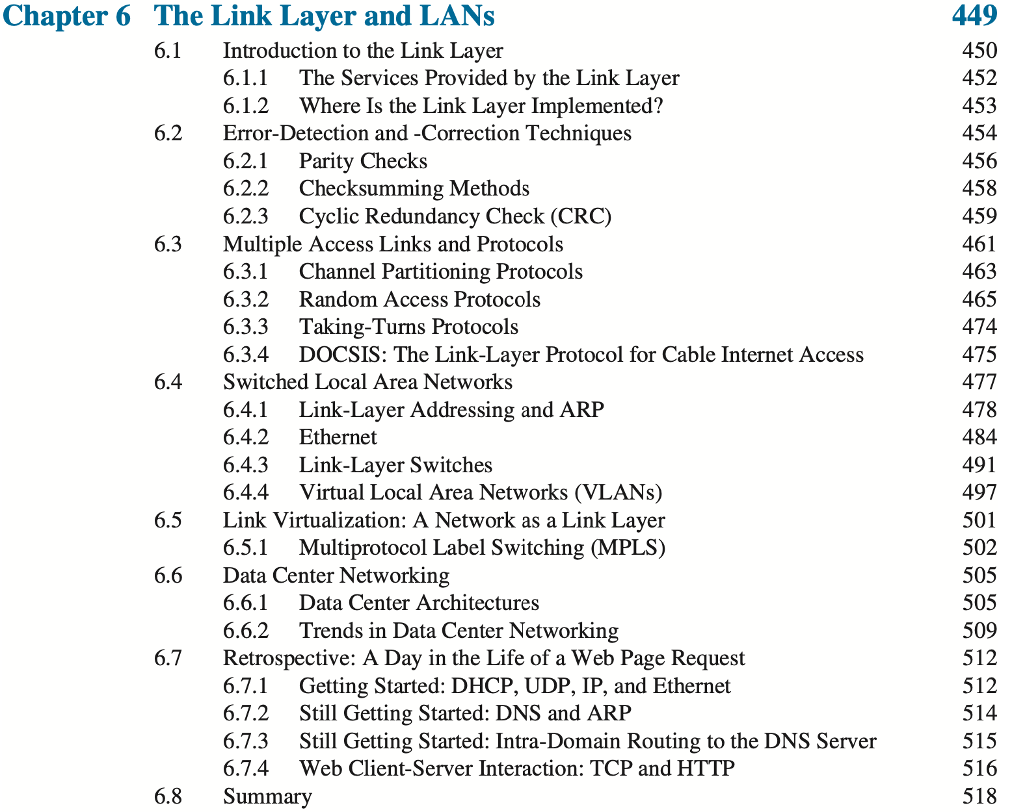

Next week: The link layer
Computer Networking: A Top-Down Approach . 8th edition Jim Kurose, Keith Ross Pearson, 2020
Please read pp 449-456 (stop at single bit parity); 461-470; 477-501; 505-519.

